Slide 2




What is Design Pattern
Design pattern is a general reusable solution to a commonly occurring problem in software design.
A design pattern is not a finished design that can be transformed directly into code. It is a description or template for how to solve a problem that can be used in many different situations.

Slide 3

Why Design Patterns
•To design a new software system quickly and efficiently.
•To understand a existing software system.

Slide 4

Introduction
Promote reuse.
Use the experiences of software developers.
A shared library/lingo used by developers.
“Design patterns help a designer get a design right faster”.

Slide 5

Introduction
Based on the principles of object-oriented programming: abstraction, inheritance, polymorphism and association.
Are solutions to recurring problems to software design.
Are independent of the application domain.
Example – Variability of interfaces – the modeller view controller (MVC) pattern.

Slide 6

Object-Oriented Principles
Involves identifying:
Classes and objects
What to encapsulate
Association hierarchies
Inheritance hierarchies
Interface hierarchies
Object-oriented designs are evaluated in terms of how reusable, extensible and maintainable they are.

Slide 7

Types of Pattern – Catalog 1
Creational patterns
Focus on Object creation.
Focus on the best way to create instances of objects to promote flexibility, e.g. factory pattern.
Structural patterns
Focus on Relationship between entities.
Focus on the composition of classes and objects into larger structures, e.g. the adapter pattern.
Behavioural patterns
Focus on Communication between objects
Focus on the interaction between classes or objects,
e.g. the observer pattern.

Slide 8

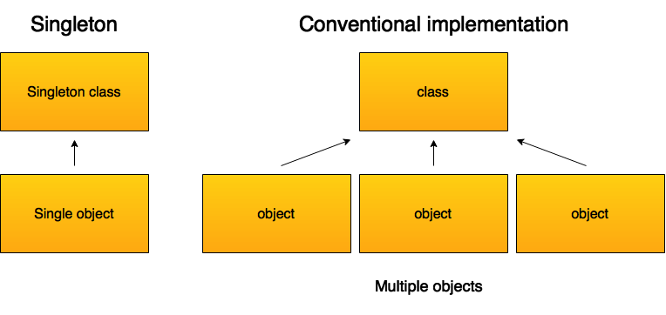
Singleton Design Pattern
Ensure a class has only one instance, and provide a global point of access to it.
Encapsulated “just-in-time initialization” or “initialization on first use”.
Type : Creational pattern.

Slide 9
Singleton Pattern
This pattern involves a single class which is responsible to create an object while making sure that only single object gets created
This class provides a way to access its only object which can be accessed directly without need to instantiate the object of the class.

Slide 10
Implementation
We're going to create a SingleObject class.
SingleObject class have its constructor as private and have a static instance of itself.
SingleObject class provides a static method to get its static instance to outside world.
SingletonPatternDemo, our demo class will
use SingleObject class to get a SingleObject object.

Slide 11
Step 1
Create a Singleton Class. (SingleObject.java)
public class SingleObject {
//create an object of SingleObject
private static SingleObject instance = new SingleObject();
//make the constructor private so that this class cannot be
//instantiated
private SingleObject(){}
//Get the only object available
public static SingleObject getInstance(){ return instance;
}
public void showMessage(){ System.out.println("Hello World!");
}
}

Slide 12
Step 2
Get the only object from the singleton class.
SingletonPatternDemo.java
public class SingletonPatternDemo {
public static void main(String[] args) {
//illegal construct
//Compile Time Error: The constructor SingleObject() is not visible
//SingleObject object = new SingleObject();
//Get the only object available
SingleObject object = SingleObject.getInstance();
//show the message object.showMessage();
}
}

Slide 13
Step 3 Verify the output.
Hello World!

